Slide 1


Slide 2

Tutorial 16 Sections 009/010
TA: Greydon Gilmore
Physiology 2130
Feb 4th, 2020

Slide 3

Your TA reminding you…
3rd Peerwise assignment (1.5%)
Post 2 MC questions: due Feb 12th @ midnight
Answer 5 MC questions: due Feb 14th @ midnight
3rd Quiz (1%)
Opens: Feb 24th @ 4pm
Closes: Feb 25th @ 4pm
3rd Midterm (15%)
When: Feb 28th @ 6pm-7pm

Slide 4
Today
Group work activity
Learning Catalytics Question
Respiratory Physiology

Slide 5
Group Work

Slide 6
You have 1.5 minutes to answer each question—discuss as a group and come to a consensus.
Write your team name on the top of the paper along with your group #
As a group you have 90 seconds to discuss and write down your answer on your paper
There are 5 questions

Slide 7
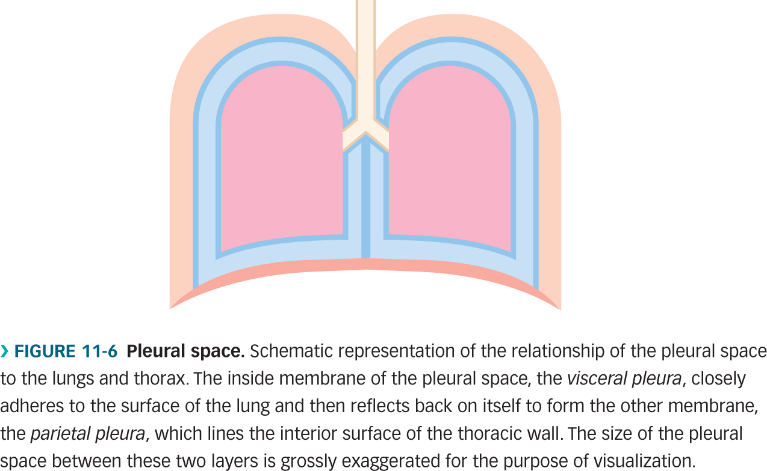
Question 1
Based on what you learned in class, what is the state of this person’s lungs in the above scenario?
This person is inhaling
This person is exhaling
This person has a pneumothorax
This person is not breathing
760 mmHg
754 mmHg
Atmospheric pressure is 760 mmHg, intrapleural pressure is 754 mmHg. At rest, the intrapleural pressure is 757 mmHg. When you breath in, the volume gets larger and the pressure gets lower (Boyle’s law). Thus, this person has to be breathing inward, since the intrapleural pressure lower than at rest.

Slide 8
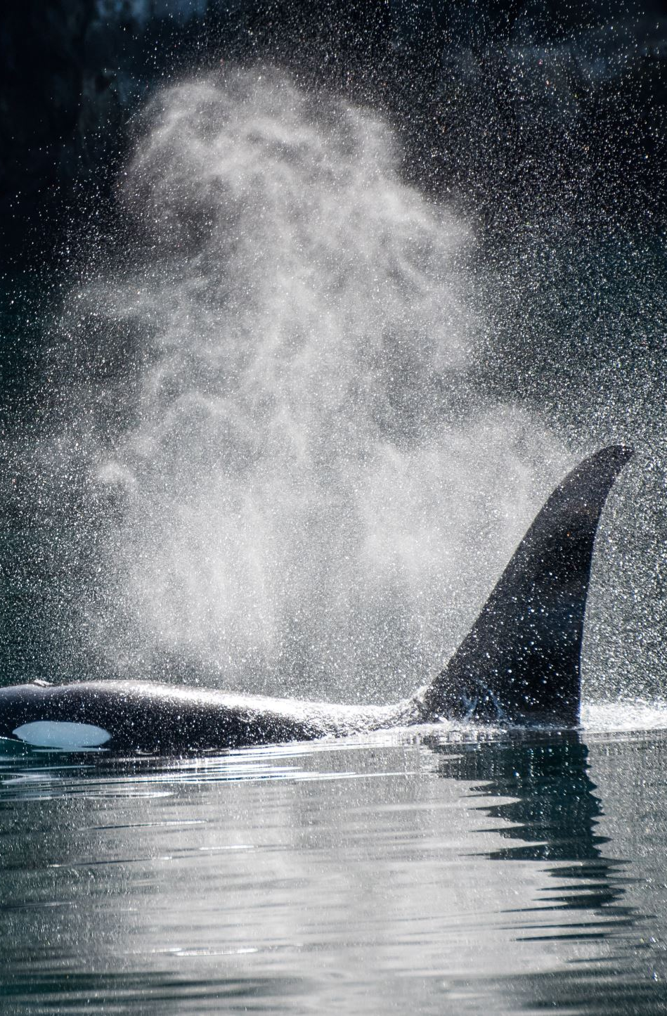
Question 2
Air is moving through your lungs but not a single muscle involved in breathing is contracting. Why?
you are inhaling at rest
you are exhaling at rest
you are inhaling while swimming hard
you are exhaling while swimming hard
When exhaling (passively) the diaphragm and external intercostal muscles relax. Swimming hard would be active breathing.

Slide 9
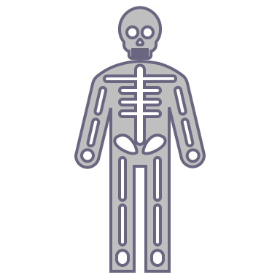
Question 3
Dorothy has a genetic condition that causes her to not produce pulmonary surfactant. What is true about Dorothy’s lungs?
Dorothy has low surface tension in her lungs
Dorothy has excellent lung compliance
Dorothy has poor gas exchange into her blood
Dorothy has too much elastin in her lungs
Pulmonary surfactant reduces surface tension, without it tension would be higher. Compliance would decrease due to the increase in surface tension. The decrease in compliance would result in poor gas exchange.

Slide 10
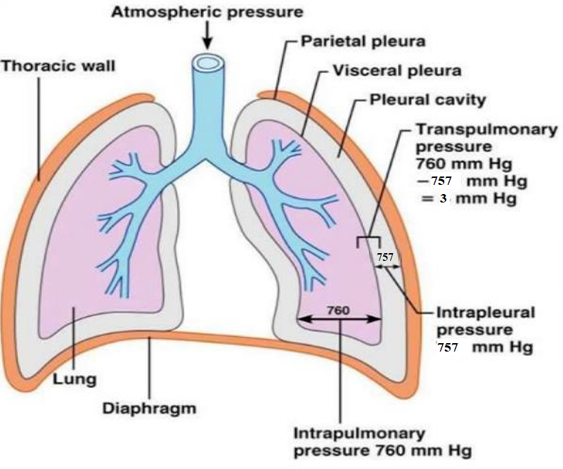
Question 4
What is true about the visceral pleura?
On one side is the lung and the other side is fluid
A hole in this membrane would cause a pneumothorax, as long as the chest wall was also punctured
This membrane directly contacts/covers the diaphragm
One membrane surrounds both lungs forming one compartment in the thoracic cavity
A hole in the visceral pleura OR parietal pleura would cause pneumothorax. Visceral pleura is next to the lung and pleural cavity.

Slide 11

Question 5
Four roommates are running. They each breathe 700 mL per breath. Based on this information alone, who likely has the best gas exchange?
They all have the same gas exchange
Matt, because he is the heaviest runner
Kate, because she breathes the slowest
Tim, because he is the lightest runner
Matt
250 lb
Kate
175 lb
Tim
160 lb
Joe
195 lb
Hint is how you calculate anatomical dead space (weight * Resp rate.). With lower resp rate the dead space would be less, meaning the alveolar ventilation would be higher! V_{A} = V_{E} - V_{D}

Slide 12
Practice Calculations
Patrick Mahomes has finished his season. In a post-game physical, his lung function test shows he has a resting tidal volume of 600 mL and breathes at 15 breaths/min. He weighs 104 kg (230 pounds).
What is his pulmonary ventilation per minute?
What is his alveolar ventilation per minute?
How much anatomical dead space does he have in his lungs?

Slide 13
Practice Calculations
Patrick Mahomes has finished his season. In a post-game physical, his lung function test shows he has a resting tidal volume of 600 mL and breathes at 15 breaths/min. He weighs 104 kg (230 pounds).
What is his pulmonary ventilation per minute?
V_{E} = V_{T} x RR = 600 mL x 15 breaths/min = 9000 mL/min or 9 L/min
What is his alveolar ventilation per minute?
V_{E} = V_{A} + V_{D}
9 L/min = ? + (230 mL * 15 breaths/min)
9 L/min = ? + (3.45 L/min)
9L/min – 3.45 L/min = V_{A}
V_{A} = 5.55 L/min
How much anatomical dead space does he have in his lungs?
Since he weighs 230 pounds, he has 230 mL of dead space in one breath.

Slide 14
Learning Catalytic Question

Slide 15
Respiratory System: Anatomy
Chapter 9: Dr. Beye

Slide 16
Functions of Respiratory System
Provides oxygen
Removes carbon dioxide
Regulates blood pH
Speech
Microbial defense
Chemical messenger concentrations
Traps and dissolves small blood clots

Slide 17
Lung Anatomy
Left Lung
2 Lobes
Why? The heart sits on the left side of thoracic cavity
Right Lung
3 Lobes

Slide 18
Lung Anatomy
Muscles
Intercostal muscles (between ribs)
Diaphragm (bottom)
Pleural Layers
Visceral pleura (against lungs)
Intrapleural space/cavity
Parietal pleura (against chest wall)
Visceral = Very close
Parietal = Pretty close

Slide 19
Lung Anatomy
Respiratory tract can be divided into two sections:
Conducting Zone
Respiratory Zone

Slide 20
Zones of Respiratory Tract

Slide 21
Conducting Zone
Trachea
Primary Bronchus
(Left and Right)
2⁰ Bronchi
3⁰ Bronchi
Bronchioles
Terminal Bronchioles
“Conducting zone terminates at terminal bronchioles”

Slide 22
Conducting Zone
Functions
Transport air to lungs
Filter, warm and moisten air
Microbial defense:
Bronchial epithelial cells are ciliated
Cilia sweeps mucus with trapped micro-organisms towards the trachea
Smoking reduces function of cilia

Slide 23
Respiratory Zone
Respiratory Bronchioles
Alveolar Ducts
Alveolar Sacs
Alveoli
“Respiratory zone begins at respiratory bronchioles”

Slide 24
The walls of the alveoli are composed of two types of cells, type I and II. The function of type II is to ______.
Secrete surfactant
Trap dust and other debris
Replace mucus in the alveoli
Protect the lungs from bacterial invasion

Slide 25
The walls of the alveoli are composed of two types of cells, type I and II. The function of type II is to ______.
Secrete surfactant
Trap dust and other debris
Replace mucus in the alveoli
Protect the lungs from bacterial invasion

Slide 26
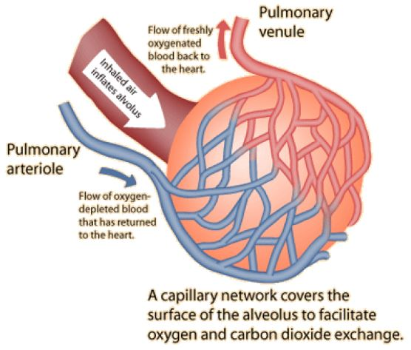
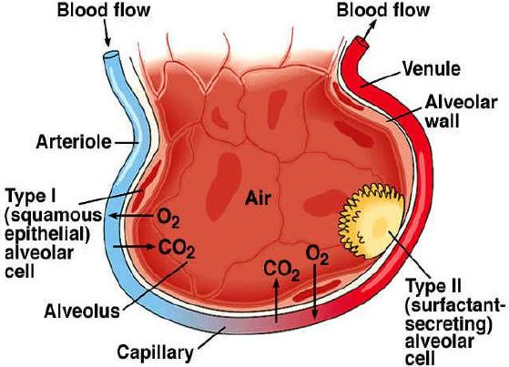
Respiratory Zone
Function
Gas exchange in the alveoli at the blood gas barrier
CO² leaves blood supply into air
O² leaves air into blood supply
Cells
Type 1 cell: flat and thin cells that form alveolar wall and allow for easy gas exchange between alveoli and capillary
Type 2 cell: secrete surfactant
Macrophages: destroy microorganisms

Slide 27
Mechanisms of Breathing
Chapter 9: Dr. Beye

Slide 28
Ventilation Calculations
Tidal Volume: Amount of air entering lungs in one breath during normal inhalation
Respiratory Rate: # of breaths per minute
Pulmonary Ventilation (V_{E}): Amount of air entering lungs (both zones) per minute
V_{E} = Tidal Volume x Respiratory Rate
Anatomical Dead Space Ventilation (V_{D}): Amount of air not involved in gas exchange (Anatomical dead space = 1 mL/pound)
V_{D} = Weight x Respiratory Rate
Alveolar Ventilation (V_{A}): Amount of air entering only the respiratory zone per minute
V_{A} = V_{E} - V_{D}

Slide 29
Ventilation Calculations
Example: For a 150 lb individual with respiratory rate of 30 breaths/min and tidal volume of 200 mL/breath
V_{E} = Tidal Volume x Respiratory Rate
= 200 x 30
= 6000 mL/min
V_{D} = Weight x Respiratory Rate
= 150 x 30
= 4500 mL/min
V_{A} = V_{E} – V_{D}
= 6000 – 4500
= 1500 mL/min
By changing your pattern of breathing, you can alter how much air is actually available for gas exchange (V_{A})

Slide 30
Complete the following statement using the choices below. Air moves out of the lungs when the pressure inside the lungs is…
Less than the pressure in the atmosphere.
Greater than the pressure in the atmosphere.
Equal to the pressure in the atmosphere.
Greater than the intra-alveolar pressure.

Slide 31
Complete the following statement using the choices below. Air moves out of the lungs when the pressure inside the lungs is…
Less than the pressure in the atmosphere.
Greater than the pressure in the atmosphere.
Equal to the pressure in the atmosphere.
Greater than the intra-alveolar pressure.

Slide 32
Pressure
Gases move down a pressure gradient
For air to move into and out of our lungs, there must be a pressure gradient
Atmospheric pressure: 760 mmHg
Intrapulmonary pressure: 760 mmHg
Since atmosphere pressure is fixed, intrapulmonary pressure must change to create a pressure gradient during respiration
Boyle’s Law:
P = 1/V (Change volume of thoracic cavity to alter pressure)

Slide 33
Inhalation
Diaphragm and external intercostal muscles contract (Diaphragm moves down and intercostals pull ribcage up and out)
Thoracic cavity expands (Increase volume)
Decrease intrapulmonary pressure by Boyle’s law (<760 mmHg)
Air moves in

Slide 34
Exhalation (Passive)
Diaphragm and external intercostal muscles relax (Diaphragm moves up and ribcage gets smaller)
Thoracic cavity decreases in volume
Increase intrapulmonary pressure by Boyle’s law (>760 mmHg)
Air moves out

Slide 35
Exhalation (Active - Exercise)
Diaphragm and external intercostal muscles relax
Internal intercostals, obliques and rectus abdominus contract
Thoracic cavity decreases in volume
Increase intrapulmonary pressure by Boyle’s law (>760 mmHg)
Air moves out

Slide 36
Intrapleural and Transpulmonary Pressure
Intrapleural Pressure: Pressure in intrapleural space; 757 mmHg
Prevents lung from collapsing at the end of expiration
Allows for easy expansion of the lung
Transpulmonary Pressure: Pressure across the lung; +3 mmHg
Intrapulmonary Pressure (760) – Intrapleural Pressure (757)

Slide 37
Pneumothorax
Spontaneous hole in visceral pleura or puncture hole in parietal pleura
Air rushes into intrapleural space
Transpulmonary pressure becomes 0 mmHg
Lung collapses in and chest wall springs out

Slide 38
Next Tutorial (Feb 11th)
More respiratory physiology!

Slide 39
What Questions Do You Have?
You can ask in the Owl forums as well!
Also anonymously ask questions in the online dropbox!!

